Slide 2
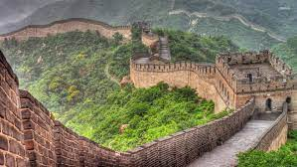
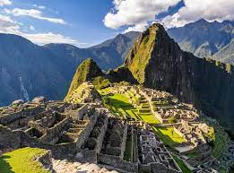
Game: Around the world
Rule: Look at the pictures and guess the places
The great wall of China
Machu Picchu

Slide 3
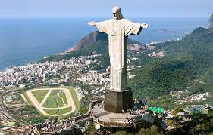
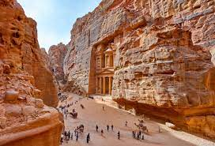
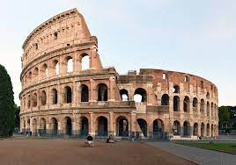
Christ the Redeemer
Petra
Roman Colosseum

Slide 4
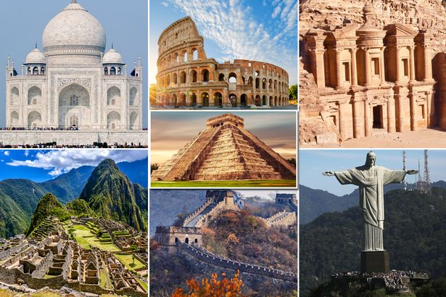
What’s the topic of the lesson today?
THE WONDERS OF THE WORLD

Slide 5
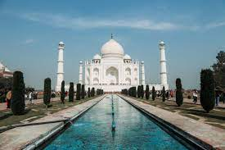
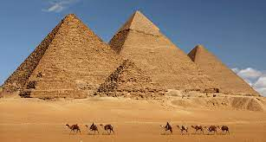
Look at the pictures and answer the questions

Slide 6
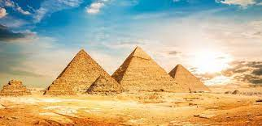
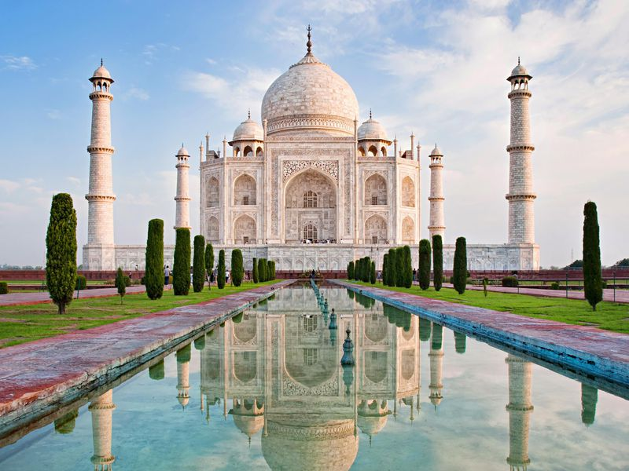
1. Can you name these two wonders of the world?
These two wonders are Great Pyramid Cheop (Khufu), and the Taj Mahal.
2. Where do you think they are located?
The Great pyramid Cheop is in Cairo, Egypt, and the Taj Mahal in
India.

Slide 7
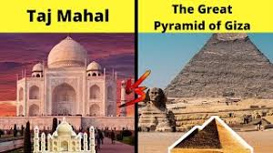
3. What do you know about them?
They were built as tombs for their royal families. The Great Pyramid was built over 4000 years ago. And the Taj Mahal was built from 1630 to 1652 by an Indian king.

Slide 8
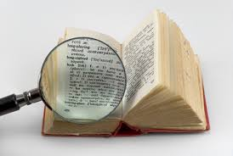
NEW VOCABULARIES

Slide 9
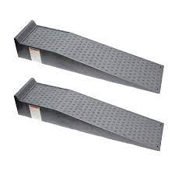
tomb (n) /tuːm/ lăng mộ
ramp (n) /ræmp/ a slope that joins two parts of a road, path, building, etc. when one is higher than the other: con dốc

Slide 10
belongings (n) /bɪˈlɒŋɪŋz/ =possessions: đồ đạc
surpass (v) /səˈpɑːs/do or be better than somebody/something: vượt qua
He hopes one day to surpass the world record.
(Anh ấy hi vọng một ngày vượt qua kỷ lục thế giới)

Slide 11
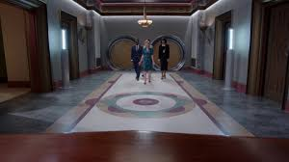
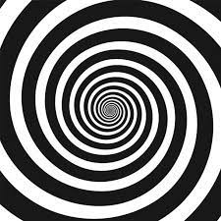
chamber (n)/ˈtʃeɪmbə(r)/ a hall in a public building: phòng lớn
spiral (n) /ˈspaɪrəl/ hình xoắn ốc

Slide 12
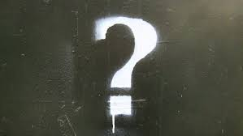
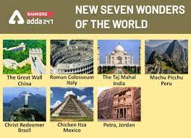
mysterious (adj) /mɪˈstɪəriəs/: difficult to understand or explain: bí ẩn
wonder (n) /ˈwʌndə(r)/ =marvel: kì quan

Slide 13
Read the passage and then do the tasks that follow.
The Great Pyramid of Giza was built by the Egyptian pharaoh Khufu around the year 2560 BC. The purpose of this huge stone pyramid was to serve as a tomb when he died and to protect the burial chamber from the weather and from thieves who might try to steal the treasures and belongings there. The Great Pyramid is believed to have been built over a 20-year period. First, the site was prepared and then the huge blocks of stone were transported and put in their places.
When it was built, the Great Pyramid was 147 metres high on a base of 230 square metres. It ranked as the tallest structure on earth for more than 43 centuries, only to be surpassed in height in the nineteenth century AD. The structure consisted of approximately 2 million blocks of stone, each weighing about 2.5 tons. It has been suggested that there are enough blocks in the three pyramids to build a 3-metre high. 0.3-metre-thick wall around France.

Slide 14
Although it is not known how the blocks were put in place, several theories have been proposed. One theory involves the construction of a straight or spiral ramp that was raised as the construction proceeded. A second theory suggests that the blocks were lifted and placed using thousands of huge weight arms.
Today, the Great Pyramid of Giza is enclosed, together with the other pyramids in the tourist region of the Giza Plateau on the west bank of the River Nile. Also in the area is the museum housing the mysterious Sun Boat, only discovered in 1954 near the south side of the pyramid. The boat is believed to have been used to carry the body of Khufu in his last journey on earth before being buried inside the pyramid.

Slide 15
Task 1. The words in the box all appear in the passage. Fill each blank with a suitable word.
tomb
Last week we paid a visit to the _______ of an unknown mandarin.
2. The movie was about a _______ of the world.
3. A _______ is needed at the exit and entrance for wheelchairs users.
4. The Queen's private _______ is not opened to public.
5. It’s not known why Beson disappeared in _______ circumstances.
7. A snail’s shell is _______ in form.
wonder
ramp
chamber
mysterious
spiral

Slide 16
Task 2. Answer the following questions.
1. Where is the Great Pyramid of Giza situated and when was it built?
It is located on the west bank of the River Nile and it was built around the year 2560 B.C.
2. How high and large was the Great Pyramid of Giza?
It was about 147 metres high on a base of 230 metres square.
3. What was the purpose of this huge stone Pyramid? The purpose of this huge stone Pyramid was to serve as a tomb when the Egyptian Pharaoh Khufu died and to protect the burial chamber from the weather and from thieves who might try to steal the treasures and belongings there.

Slide 17
Task 2. Answer the following questions.
4. How did the people of ancient Egypt build the Great Pyramid?
It is thought that the ancient Egyptian used straight or spiral ramps/or huge weight arms to lift and place the blocks of stone.
5. According to the passage, what is the boat believed to have been used for?
The boat is believed to have been used to carry the body of Khufu in his last journey on earth before being buried inside the pyramid.

Slide 18
Task 3. Scan the text and say what the following words refer to.
1. who (line 4) _________.
2. it (line 8) _________.
3. it (line 9) _________.
4. each (line 12) _________.

Slide 19
1. who (line 4) refers to the thieves.
2. it (line 8) refers to the Great Pyramid.
3. it (line 9) refers to the Great Pyramid.
4. each (line 12) refers to the block of stone.

Slide 20
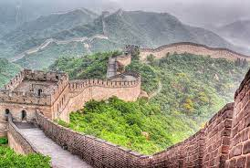
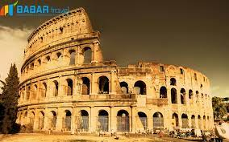
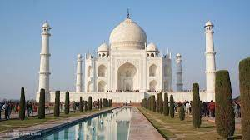
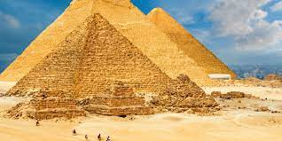
Which of the wonders of the world do you prefer and why?
The Great Wall of China
Christ the Redeemer
Colosseum
Taj Mahal
Giza Pyramids

Slide 21
HOMEWORK
Learn by heart vocabulary.
Translate the text into Vietnamese.
Prepare the new lesson: Speaking lesson

